Slide 1
„Representing and promoting the importance of University Sport”

Slide 2
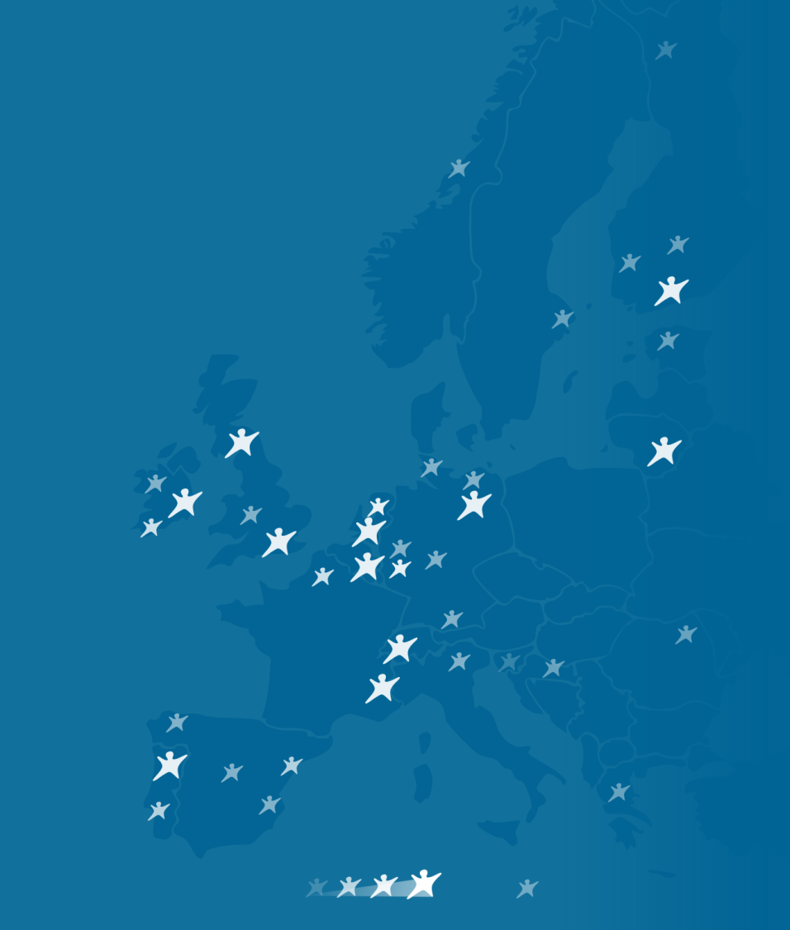
About ENAS
Non-profit organisation
Bringing together professional staff working in the HE sector, delivering student sport and physical activity
Since 1997,
representing:
126
institutions
5000
sports staff
2.5
22
million
countries
students
© European Network of Academic Sports Services 2
Notes:
A sport service in another European country may be much more similar to your institution than the people who are sitting here in this room.

Slide 3
Our purposes and mission
„Representing and promoting the importance of University sport.”
© European Network of Academic Sports Services 3

Slide 4
Our activities
Our activities include:
Events - Annual Forum & General Assembly
Experiences - Training & development events
Digital interaction Webinars and online member platform
Member recognition - Annual best practice award
Partnership working - Project delivery and support
Representing the HE sport sector, at the European level
© European Network of Academic Sports Services 4

Slide 5
Membership Benefits
Exchange ideas, knowledge and good practices
Enjoy preferential rates at all of our events and get exclusive access to live streaming of the ENAS Forum
Get access to online platform, resources, benchmarking information and member database
Enter our annual ENAS Award for industry best practice worth €2.500
Access affordable staff training and development opportunities
Receive regular sector updates and promote your own activities via our newsletter
Establish partnerships and meet new European contacts through excellent networking opportunities
Annual fee: €400,-
More via www.enas-sport.net
European Network of Academic Sports Services - 5

Slide 6
Other projects & opportunities
ACE - Active Campus Europe – Erasmus + Funded project to exchange methods to reach the most inactive populations.
https://activecampuseurope.eu/
GAME - Erasmus + Funded project to combat
doping use in recreational contexts.
DIGI-Sporting – Erasmus + Funded project to enhance
sport science (analyst) roles within sports organisations
Benchmarking – A study of the University sport landscape every 3 years combining info on financing, facilities, governance and projects.
ENAS Award – Annual Award presented at the Forum recognising excellent
practice by a member University.
© European Network of Academic Sports Services 6

Slide 7
Contact
Andrea Castagna ENAS Development Manager Andrea.castagna@enas-sport.net
© European Network of Academic Sports Services - 7

